Slide 1
Socket I/O
Shawn Fitzpatrick

Slide 2
What is a Socket?
When we want to communicate with another computer or server we open a port and attach a socket.
Once the socket is in place and the port is open communication can commence.
Sockets are code that is developed which enables communication between a client and a server.
FTP, SMTP, SFTP are examples of a few types of communication protocols that flow throw a socket.

Slide 3
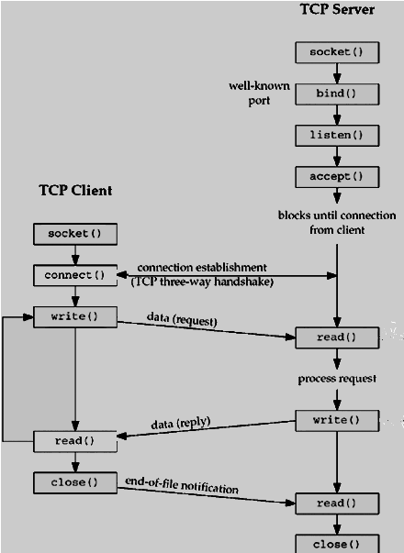
Communication Path

Slide 4
Two Socket I/O Projects on Git Hub
https://github.com/LearnBoost/socket.io/wiki/Contributing

Slide 5
Socket Communication
Configuring socket I/O:
https://github.com/LearnBoost/Socket.IO/wiki/Configuring-Socket.IO

Slide 6
What Protocol and Encoding are needed?
https://github.com/LearnBoost/socket.io-spec

Slide 7
Example of other Socket I/O Code
Actual code for Java Script Client and Server
http://socket.io/#home

Slide 8
Sources Cited
http://www.tutorialspoint.com/unix_sockets/what_is_socket.htm
https://github.com/LearnBoost/Socket.IO/wiki/Configuring-Socket.IO
https://github.com/LearnBoost/socket.io-spec
https://github.com/LearnBoost/socket.io/wiki/Contributing
http://socket.io/#home

